Slide 1
'omics' Data Analysis
1. Biology in a nutshell

Slide 2
Cells and organisms
Organisms
Unicellular: One single cell (or simpler)
Archaea
Prokaryotes: Bacteria, Yeast
Eukaryote: Protozoos
Pluricellular: Eukaryote cells
Different organitation levels (e.g. tissues)
Diversity in number, type and syze
Viruses are not properly organisms
Notes:
2

Slide 3
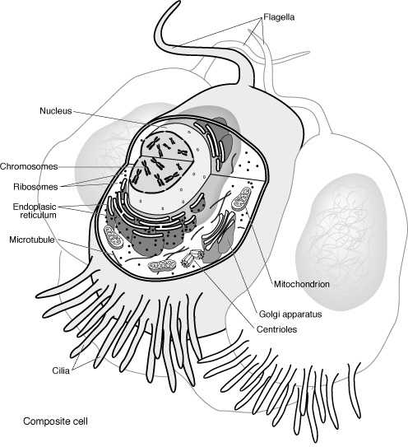
Eukaryotes
“Eu” good, “Karyo” nut or kernel →
Presence of nucleous separated from del cytoplasm by the nucleous envelope.
DNA: double-stranded, it is organized in chromosomes
The cell contains other membrane-bound organelles
Sexual reproduction is common
Notes:
3

Slide 4
Key biomolecules
The basic components of biological systems are
Sugars (carbohydrates)
Fats (lipids)
Nucleic acids
Proteins
Sugars and lipids have no important role regarding “biological information”: Not discussed here
Notes:
4

Slide 5
Nucleic acids and proteins
Molecules that contain and transport information
DNA (4 different nucleotides)
Contains encoded biological information
RNA (4 different nucleotides)
Carries information from DNA to proteins
Proteins (20 different amino acids)
Function and structure of living beings
Notes:
5

Slide 6
Nucleotides
Basic components of nucleic acids
Consisting of
A sugar (Ribose or Deoxyribose)
A nitrogen base
A phosphate group
In biological parlance we speak of "bases" instead of nucleotides to describe a string (3000bp = 3000 bp)
Notes:
6

Slide 7
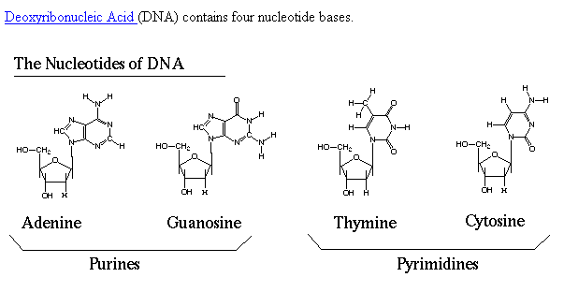
DNA nucleotides
Notes:
7

Slide 8
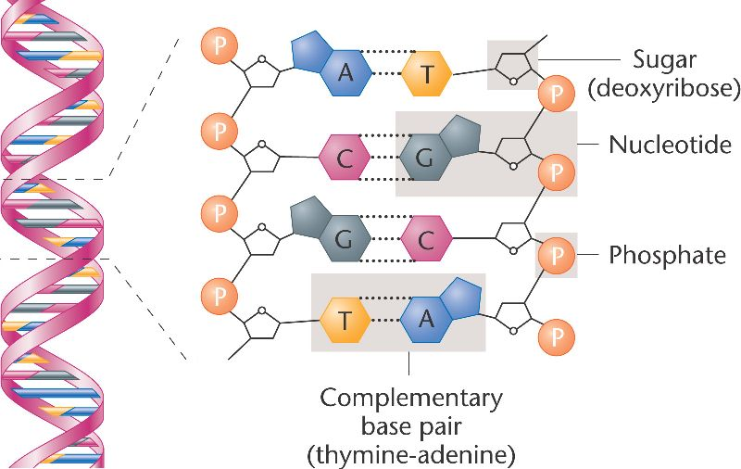
The pairing between complementary bases
Notes:
8

Slide 9
The primary structure of DNA
Sequence of nuceotides
Forms an unbranched polymer
Organized in a double-stranded
atgaatcgta ggggtttgaa cgctggcaat
acgatgactt ctcaagcgaa cattgacgac
ggcagctgga aggcggtctc cgagggcgga
Notes:
9

Slide 10
DNA vs RNA
DNA is organized into a complementary double helix. RNA does not.
One of the four bases are different
DNA: A, C, G, T
RNA: A, C, G, U
Differ from the nucleotide sugar
DNA: Deoxyribose
ARN: Ribose
Notes:
10

Slide 11
Proteins
Amino acid sequence
Forms an unbranched polymer
There are 20 different amino acids (AA)
The key function of proteins is in its three dimensional structure
Notes:
11

Slide 12
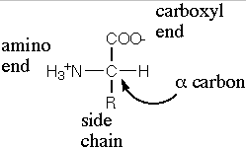
Amino acids
Notes:
12

Slide 13
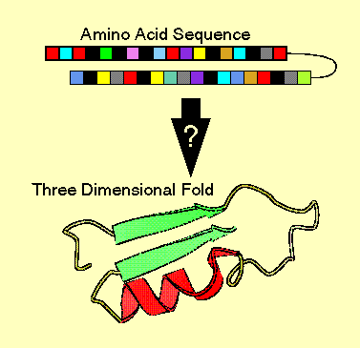
Proteins “fold” into conformational structure
Notes:
13

Slide 14
Protein's structure
Proteins fold into lowest to highest complexity level:
Primary structure: amino acid sequence
Secondary structure: regularly repeating local structures stabilized by hydrogen bonds.
Tertiary structure: fold into 3-dimensional structures.
Quaternary structure: structure formed by several protein molecules (protein complex).
Notes:
14

Slide 15
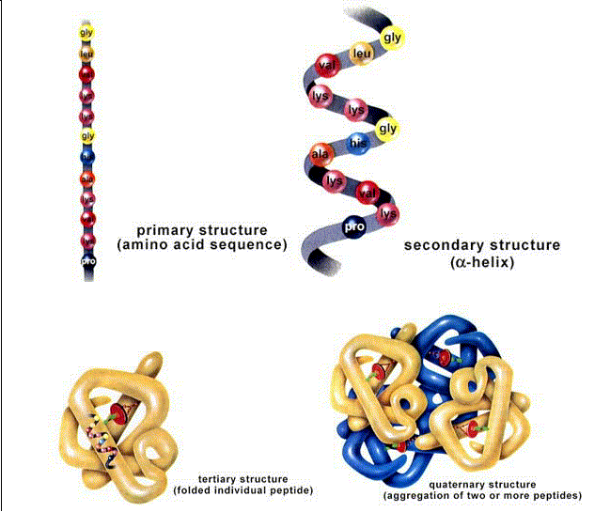
Notes:
15

Slide 16
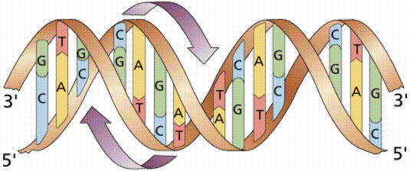
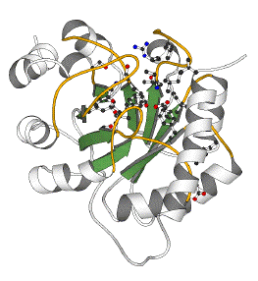
The central dogma of molecular biology
DNA
CCTGAGCCAACTATTGATGAA
transcription
mRNA
CCUGAGCCAACUAUUGAUGAA
translation
Protein
PEPTIDE

Slide 17
From DNA to proteins
DNA is replicated in a complex process involving many enzymes: replication
DNA is copied in a string of complementary messenger RNA (mRNA): transcription transcription
In eukaryotic cells, the mRNA is processed splicing eliminating coding fragments (“splicing”) and migrates from the nucleous to the cytoplasm.
The mRNA carries coded information to ribosomes (ribosomal RNA) that "read" and perform protein synthesis: translation
Notes:
17

Slide 18
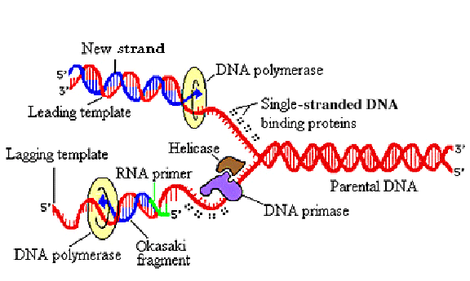
1. Replication
Animations (1), (2), (3)
Notes:
18
The major types of proteins, which must work together during the replication of DNA, are illustrated, showing their positions.
When DNA replicates, many different proteins work together to accomplish the following steps:
The two parent strands are unwound with the help of DNA helicases.
Single stranded DNA binding proteins attach to the unwound strands, preventing them from winding back together.
The strands are held in position, binding easily to DNA polymerase, which catalyzes the elongation of the leading and lagging strands. (DNA polymerase also checks the accuracy of its own work!).
While the DNA polymerase on the leading strand can operate in a continuous fashion, RNA primer is needed repeatedly on the lagging strand to facilitate synthesis of Okazaki fragments. DNA primase, which is one of several polypeptides bound together in a group called primosomes, helps to build the primer.
Finally, each new Okazaki fragment is attached to the completed portion of the lagging strand in a reaction catalyzed by DNA ligase

Slide 19
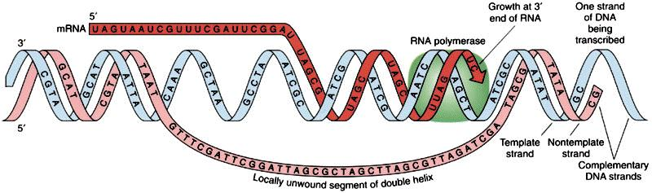
2. Transcription
Notes:
19
Transcription Before the synthesis of a protein begins, the corresponding RNA molecule is produced by RNA transcription. One strand of the DNA double helix is used as a template by the RNA polymerase to synthesize a messenger RNA (mRNA). This mRNA migrates from the nucleus to the cytoplasm.
During this step, mRNA goes through different types of maturation including one called splicing when the non-coding sequences are eliminated.
The coding mRNA sequence can be described as a unit of three nucleotides called a codon.

Slide 20
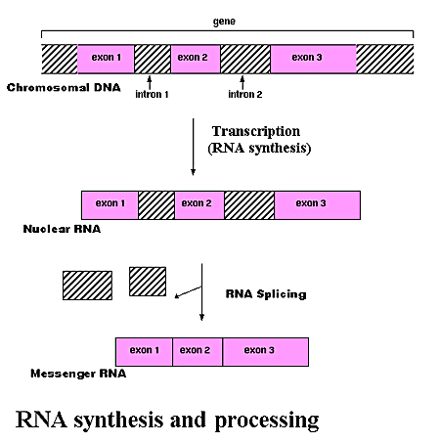
3. RNA processing or splicing
Notes:
20
Process by which non-coding sequences of base pairs (introns) are subtracted from the coding sequences (exons) of a gene in order to transcribe DNA into messenger RNA (mRNA.)
In chromosomes, DNA acts as a template for the synthesis of RNA in a process called transcription. In most mammalian cells, only 1% of the DNA sequence is copied into a functional RNA (mRNA). Only one part of the DNA is transcribed to produce nuclear RNA, and only a minor portion of the nuclear RNA survives the RNA processing steps. One of the most important stages in RNA processing isRNA splicing. In many genes, the DNA sequence coding for proteins, or "exons", may be interrupted by stretches of non-coding DNA, called "introns". In the cell nucleus, the DNA that includes all the exons and introns of the gene is first transcribed into a complementary RNA copy called "nuclear RNA," or nRNA. In a second step, introns are removed from nRNA by a process called RNA splicing. The edited sequence is called "messenger RNA," or mRNA.

Slide 21
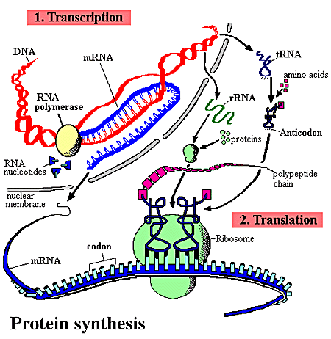
4. Protein synthesis
The mRNA goes to the cytoplasm where it binds to ribosomes.
Codon: mRNA information unit.
The tRNA brings the complementary AA tRNA.
The AA are bound to the protein to complete the sequence.
Animations (1), (2)
Notes:
21
The ribosome binds to the mRNA at the start codon (AUG) that is recognized only by the initiator tRNA. The ribosome proceeds to the elongation phase of protein synthesis. During this stage, complexes, composed of an amino acid linked to tRNA, sequentially bind to the appropriate codon in mRNA by forming complementary base pairs with the tRNA anticodon. The ribosome moves from codon to codon along the mRNA. Amino acids are added one by one, translated into polypeptidic sequences dictated by DNA and represented by mRNA. At the end, a release factor binds to the stop codon, terminating translation and releasing the complete polypeptide from the ribosome.
One specific amino acid can correspond to more than one codon. The genetic code is said to be degenerate.

Slide 22
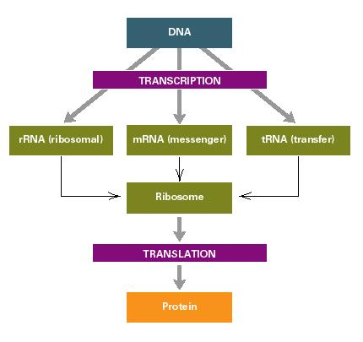
Notice: 1 DNA vs. 3 RNA’s !
Notes:
22

Slide 23
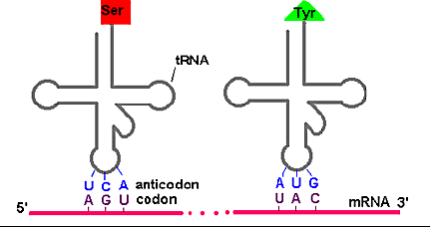
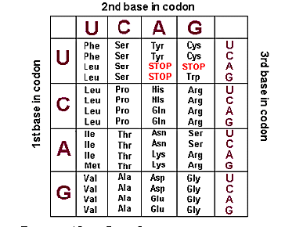
The genetic code
Notes:
23
Amino acids specified by each codon sequence on mRNA. Key for the above table: Ala: Alanine Cys: Cysteine Asp: Aspartic acid Glu: Glutamic acidPhe: Phenylalanine Gly: GlycineHis: Histidine Ile: Isoleucine Lys: LysineLeu: Leucine Met: MethionineAsn: AsparaginePro: ProlineGln: GlutamineArg: ArginineSer: SerineThr: ThreonineVal: ValineTrp: TryptophaneTyr: TyrosisneA = adenine G = guanine C = cytosine T = thymine U = uracil DNA transfers information to mRNA in the form of a code defined by a sequence of nucleotides bases.
During protein synthesis, ribosomes move along the mRNA molecule and "read" its sequence three nucleotides at a time (codon) from the 5' end to the 3' end.
Each amino acid is specified by the mRNA's codon, and then pairs with a sequence of three complementary nucleotides carried by a particular tRNA (anticodon).
Since RNA is constructed from four types of nucleotides, there are 64 possible triplet sequences or codons (4x4x4). Three of these possible codons specify the termination of the polypeptide chain. They are called "stop codons". That leaves 61 codons to specify only 20 different amino acids. Therefore, most of the amino acids are represented by more than one codon. The genetic code is said to be degenerate.

Slide 24
What is a gene? (pre ENCODE)
A gene used to be defined as ...
The functional and physical unit of heredity,
transmitted from one generation to their offsprings,
consisting of DNA fragments,
with the information needed for the synthesis of a specific protein (most of them...)
Notes:
24

Slide 25
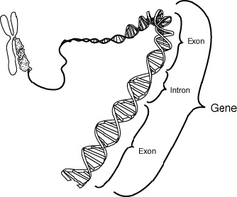
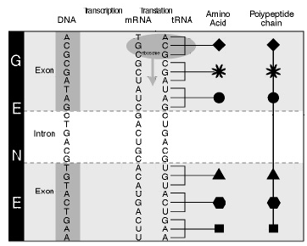
Gene components
Notes:
25

Slide 26

The ENCODE project
In September 2003 The National Human Genome Research Institute (NHGRI) launched a public research consortium named ENCODE, the Encyclopedia Of DNA Elements
Its goal was “to carry out a project to identify all functional elements in the human genome sequence”
The findings of the ENCODE project have led to re-consider foundamental ideas such as the definition of gene

Slide 27
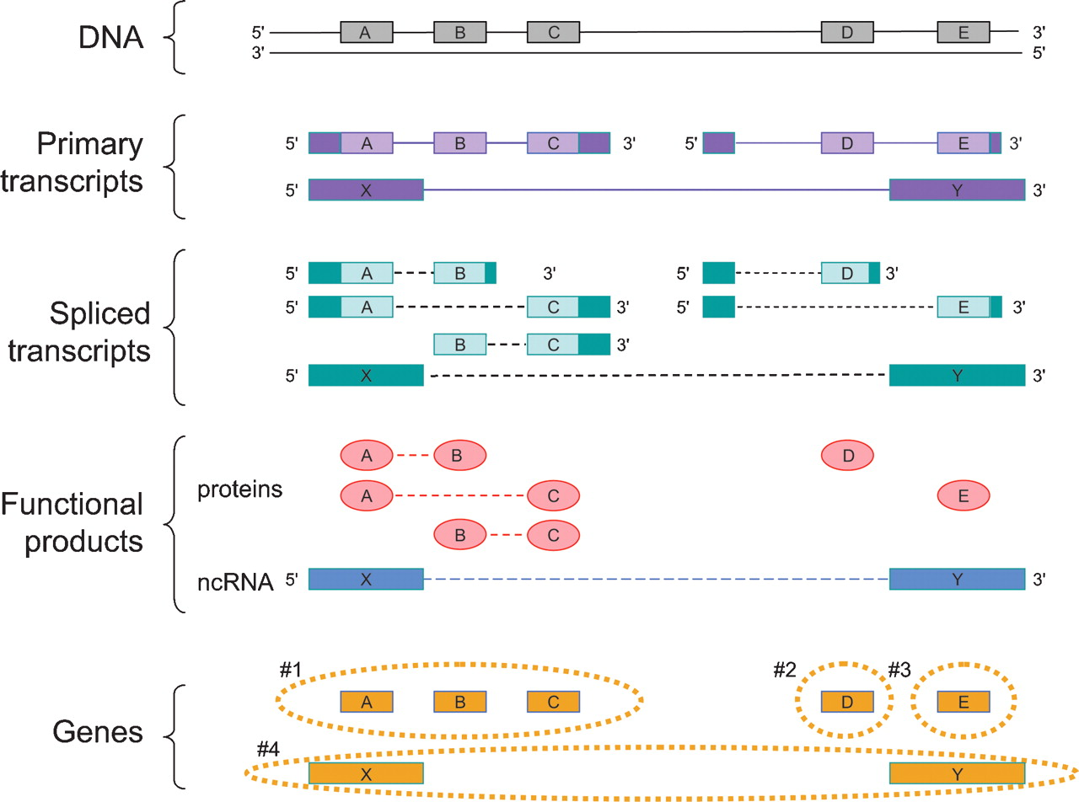
What is a gene (post-ENCODE)
Notes:
How the proposed definition of the gene can be applied to a sample case.
A genomic region produces three primary transcripts. After alternative splicing, products of two of these encode five protein products, while the third encodes for a noncoding RNA (ncRNA) product. The protein products are encoded by three clusters of DNA sequence segments (A, B, and C; D; and E). In the case of the three-segment cluster (A, B, C), each DNA sequence segment is shared by at least two of the products. Two primary transcripts share a 5′ untranslated region, but their translated regions D and E do not overlap. There is also one noncoding RNA product, and because its sequence is of RNA, not protein, the fact that it shares its genomic sequences (X and Y) with the protein-coding genomic segments A and E does not make it a co-product of these protein-coding genes. In summary, there are four genes in this region, and they are the sets of sequences shown inside the orange dashed lines: Gene 1 consists of the sequence segments A, B, and C; gene 2 consists of D; gene 3 of E; and gene 4 of X and Y. In the diagram, for clarity, the exonic and protein sequences A and E have been lined up vertically, so the dashed lines for the spliced transcripts and functional products indicate connectivity between the proteins sequences (ovals) and RNA sequences (boxes). (Solid boxes on transcripts) Untranslated sequences, (open boxes) translated sequences.

Slide 28
Gene expression
Genes can be “turned on” or “off”
When a gene is turned on we say it is expressing or being expressed
The central dogma implies that when a gene is expressed it is, at least transcribed
That is: expression → mRNA
Each cell expresses only a fraction of its genes
Remaining genes are repressed ("off")
Notes:
28

Slide 29
Regulation of gene expression
Each cell expresses (or active or "on") only a fraction of their genes.
Remaining genes are repressed ("off").
The process consisting of activating some genes and inhibiting others is globally known as gene regulation.
Gene regulation determines:
The appearance and different function of different cells types
The ability of some cells to react quickly to environmental changes
Notes:
29

Slide 30
How are genes regulated?
Gene regulation can occur at any point in the process of expression but often occurs during transcription.
Environmental signs or other cells activate proteins called transcription factor.
They bind to the regulatory regions of genes, increasing or decreasing the level of transcription → They control the amount of gene product produced by the gene in every moment.
Notes:
30

Slide 31
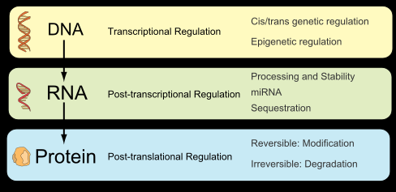
Forms of gene expression regulation
Notes:
31
31
The action of the glucocorticoid receptor is illustrated.
On the left is shown a series of genes, each of which has various gene activator proteins bound to its regulatory region. However, these bound proteins are not sufficient on their own to activate transcription efficiently.
On the right is shown the effects of adding an additional gene regulatory protein‹the glucocorticoid receptor in a complex with glucocorticoid hormone‹that can bind to the regulatory region of each gene. The glucocorticoid receptor completes the combination of gene regulatory proteins required for efficient initiation of transcription, and the genes are now switched on as a set.

Slide 32
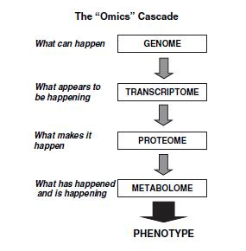
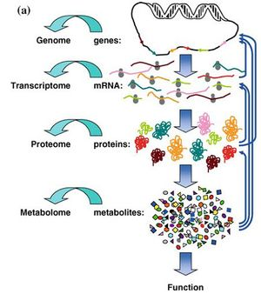
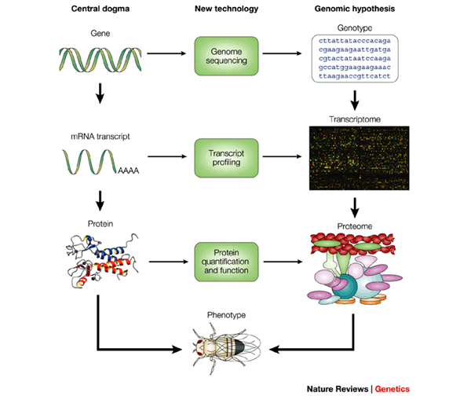
Put it altogether: The OMICS cascade
Notes:
Font: Nature Reviews Genetics 3, 43-52 (January 2002)
The central dogma outlines the flow of information that is stored in a gene, transcribed into RNA and finally translated into protein. The ultimate expression of this information is the phenotype of the organism. Each step of the central dogma is accompanied by recent technological innovations that allow genome-wide analysis. Although the central dogma once presented a view that was essentially descriptive, and limited to gene-by-gene studies, it can now be coupled with technology and viewed as experimental and testable. Hypotheses can be formulated and revised for the purpose of elucidating the detailed connections between genotype and phenotype, therefore unravelling the inner molecular biology of an organism.

Slide 33
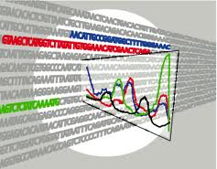
Genomics
A genome is an organism's complete set of DNA, including all of its genes
Genomics relies on sequencing technologies to study genomes and intragenomic phenomena
Notes:
Genomics is a discipline in genetics concerning the study of the genomes of organisms. The field includes intensive efforts to determine the entire DNA sequence of organisms and fine-scale genetic mapping efforts. The field also includes studies of intragenomic phenomena such as heterosis, epistasis, pleiotropy and other interactions between loci and alleles within the genome. In contrast, the investigation of the roles and functions of single genes is a primary focus of molecular biology or genetics and is a common topic of modern medical and biological research. Research of single genes does not fall into the definition of genomics unless the aim of this genetic, pathway, and functional information analysis is to elucidate its effect on, place in, and response to the entire genome's networks.

Slide 34
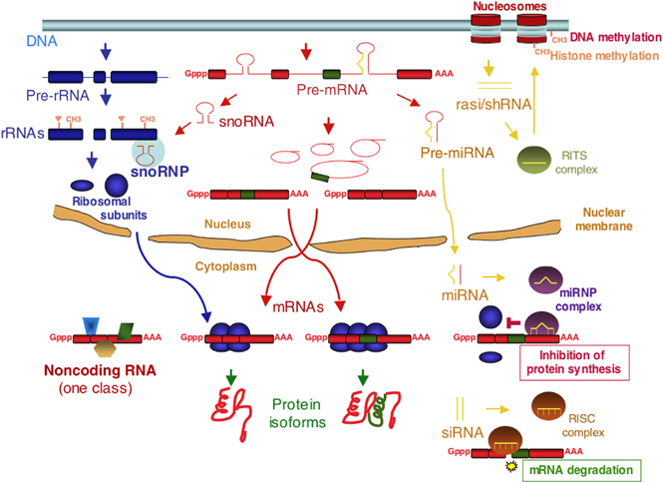
Transcriptomics
The transcriptome is the set of all RNA molecules, in one or a population of cells.
Transcriptomics, examines expression levels of mRNAs in a given cell population, often using high-throughput techniques such as
RTqPCR
microarrays or
NGS.
Notes:
The transcriptome is the set of all RNA molecules, including mRNA, rRNA, tRNA, and other non-coding RNA produced in one or a population of cells.
transcriptomics, also referred to as expression profiling, examines the expression level of mRNAs in a given cell population, often using high-throughput techniques based on DNA microarray technology. The use ofnext-generation sequencing technology to study the transcriptome at the nucleotide level is known as RNA-Seq.[1]

Slide 35
‘omics’ are high throughput
Most ‘omic’ approches generate huge quantities of data.
The management, storage, analysis and interpretation of these high throughput datasets cannot be conceived without all type of computing and quantitative ressources
Bioinformatics and computational biology are a must for omics sciences

